Slide 1

国际贸易专题研究
气候风险下的投入品采购：来自美国制造企业的证据
Input Sourcing under Climate Risk: Evidence from U.S. Manufacturing Firms
Blaum, Esposito & Heise (2026, ReStud)
汇报人：2026级应用经济学 姜琳
2026年10月13日
Notes:
今天讨论一个看似属于物流管理、实际贯穿贸易、金融和农业的问题：如果投入品平均仍然十九天到货，但到货时间越来越不稳定，企业会怎样调整采购？这篇论文的贡献是把航运风险测量、企业采购反应和总体经济后果连成一个可以检验的框架。报告依据大家提供的三十页正式期刊版，2026年5月14日在线发表。我的评价和教学例子会单独标识，避免把研究启发当作作者已经证明的结论。
依据：主文正式期刊版，第1页｜Blaum、Esposito、Heise（2026）
计划时长：31秒

Slide 2
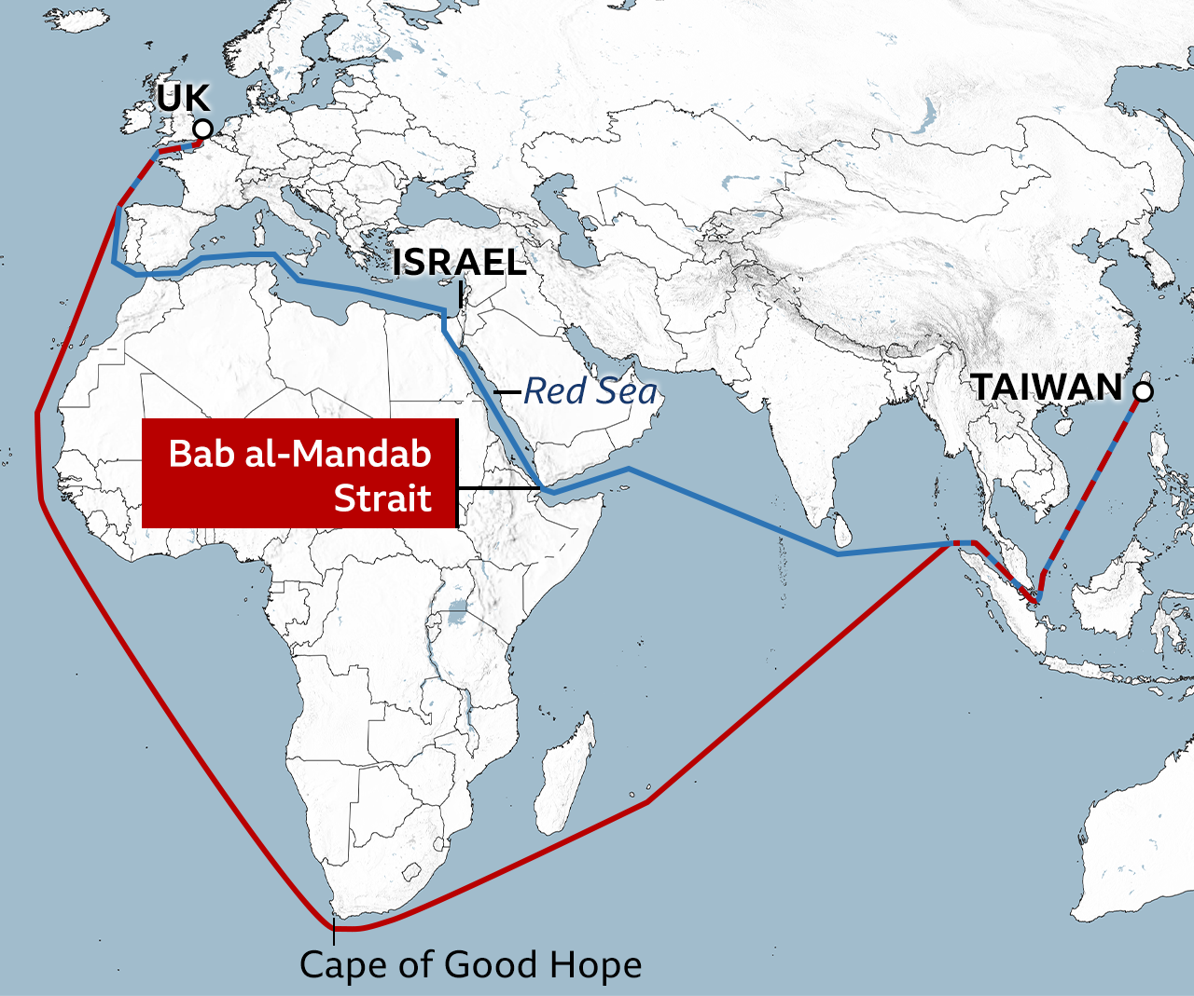
CASE STUDY 1 / 3
Opening Case: Red Sea Rerouting Changes Delivery Reliability
Blue: via the Red Sea and Suez Canal
Red: around the Cape of Good Hope
Some vessels reroute,changing their original shipping plans.
Will the cargo arrive when production needs it?
Event context: IMF, 2026-04-29. Route illustration: BBC / Veson Nautical; not a real-time shipping update.
02 / 35
Notes:
After the Red Sea shipping disruption, some vessels rerouted around the Cape of Good Hope. The blue line shows the route through the Red Sea and Suez; the red line shows the detour. This is a route illustration, not a real-time status report. We often focus on freight rates and mean transit times, but firms using imported inputs also face uncertainty about delivery schedules. If raw materials do not arrive when needed, the effects can move from logistics to production, sales, and cash flow. This paper helps us understand how transport uncertainty enters global sourcing. Real-world events may change freight costs, mean transit times, and volatility at the same time; they are not equivalent to an experiment that changes variance alone.
Event source: https://www.imf.org/en/blogs/articles/2026/04/29/global-disruptions-are-testing-how-the-world-moves-goods-and-people
Image source: BBC News, “What do Red Sea assaults mean for global trade?” https://www.bbc.co.uk/news/business-67759593; map materials by Veson Nautical. The map is cropped to illustrate routes only; the transit-day estimates based on a particular vessel speed are not cited.
Suggested speaking time: 50 seconds.

Slide 3
CASE STUDY 2 / 3
Same Mean Transit Time, but Option B Has a 50% Chance of Missing the Production Start Date
Sourcing arrangement | Option A: Reliable delivery | Option B: Variable delivery
Arrival time | 19 days each time | 10 or 28 days, each with 50% probability
Mean arrival time | 19 days | 19 days
Probability of arrival by Day 22 | 100% | 50%
Delivery reliability also affects the productive value of inputs
03 / 35
Notes:
Here is a teaching example. Suppose a firm must start production on Day 22. Option A arrives in 19 days every time. Option B arrives in 10 days half the time and 28 days the other half, so its mean is also 19 days. Yet half of Option B’s shipments miss the production deadline. The same mean transit time can therefore imply different production value. Management researchers may think of delivery service levels, finance researchers of operating cash-flow volatility, and agricultural researchers of missed planting windows. This paper studies weather-related variation in transit times; it does not directly observe this teaching deadline or test every discipline-specific mechanism. The next question is whether firms change global sourcing in response to this risk.
The example and calculations were prepared by the presenter; they are not empirical data. The research question is based on pp. 2–4 of the main paper.
Suggested speaking time: 60 seconds.

Slide 4
CASE STUDY 3 / 3
Three Trade Questions About Transport Risk
Reliable delivery unlocks the gains from cross-border sourcing
Trade question | Firm choices to observe
Where to source? | Supplier count, routes, and sourcing concentration
How much to source? | Import scale and use of foreign inputs
What is the cost of adaptation? | Source costs, firm performance, and aggregate effects
Core question: How do firms adapt, and what losses remain?
04 / 35
Notes:
[35-second explanation] The example shows that firms can face different production risks even when mean arrival times are the same. In international trade, this can change the appeal of foreign inputs relative to domestic inputs and the allocation across foreign sources. We turn the case into three research questions: where to source, how much to source, and how much loss remains after adjustment. Lower imports should not be interpreted directly as policy-driven reshoring; it is one possible firm response to risk. Real shipping events may affect freight costs, mean transit times, and volatility simultaneously. The paper uses data on U.S. manufacturing from 2011 to 2019 to study weather-related transport uncertainty specifically. We will first define the concepts and then trace how prior research leads to this question.
Based on the formal published paper, pp. 2–5. DOI 10.1093/restud/rdag031.

Slide 5
TRADE AND SUPPLY CHAIN RESILIENCE
Disruptions, Risk, Adaptation, and Resilience
Concept | Meaning in this presentation
Disruption | An unusually long transit time that has already occurred
Risk | Uncertainty about future transit times
Adaptation | Changes in supplier, route, and order-quantity choices
Resilience | Ability to withstand and recover; this paper studies only one part of it: adaptation
05 / 35
Notes:
A supply shock is an event that has already occurred, such as a shipment arriving late. Supply risk is the probability distribution a decision-maker faces, such as uncertainty about when the next shipment will arrive. Adaptation means that firms change sourcing, inventory, or transport choices. Resilience is the ability to withstand, absorb, and recover from shocks. The authors do not construct a comprehensive resilience index covering recovery speed, inventories, and capacity; they study transport risk and sourcing decisions. Adding suppliers is an adaptive response, but it does not automatically deliver socially optimal resilience. Here, global value-chain restructuring mainly refers to changes in import sources, routes, and import dependence, rather than a comprehensive measure of reshoring.
Source: Formal published paper, pp. 2–4 and 15–18 | Blaum, Esposito, and Heise (2026).
Suggested speaking time: 49 seconds.

Slide 6
TRADE QUESTIONS AND LITERATURE POSITIONING
What Has the Literature Studied, and What Remains?
—— From Time Costs to Transport Risk
Research strand and core question | Selected studies and main findings | What remains unanswered
1. Time Costs and Trade Barriers How does mean transit time affect trade? | Hummels & Schaur (2013, AER)；Evans & Harrigan (2005, AER) Transit time imposes substantial trade costs; each additional day in transit is equivalent to an ad valorem tariff of about 0.6%–2.1%. | The focus is mean transit time and the value of timely delivery; these studies do not identify the effect of transit-time volatility itself.
2. Supply-Chain Shock Propagation How do localized supply interruptions affect the network? | Barrot & Sauvagnat (2016, QJE)；Carvalho et al. (2021, QJE)；Boehm et al. (2019, REStat) Supplier shocks can propagate to downstream firms through input-output linkages. | Identification often centers on discrete major shocks such as earthquakes; sourcing responses to frequent, day-to-day transport risk receive less attention.
3. Supply-Chain Risk and Resilience Should firms diversify or reshore? | Grossman, Helpman & Lhuillier (2023, JPE) With CES demand, a diversification subsidy can achieve the constrained social optimum; when demand elasticity rises with price, private resilience investment may be excessive. | This work provides a policy framework, but its conclusions depend on demand conditions; it does not directly measure weather-driven transport risk and link it to firm-level sourcing data.
4. Sourcing Margins and Imported Inputs Why do firms choose particular import sources? | Antràs, Fort & Tintelnot (2017, AER)；Halpern et al. (2015, AER)；Blaum et al. (2018, AEJ: Macro) Firm heterogeneity, source-country conditions, and imported inputs jointly shape source selection and productivity. | Transit time usually enters as a cost or deterministic condition; source risk and its effect on sourcing portfolios are less often modeled explicitly.
06 / 36
Reading guide: mean delivery costs → major-shock propagation → resilience policy → firm sourcing choices
Notes:
Presenter notes (recommended: 55 seconds)
Use this slide to position the paper without discussing each study individually. The first strand treats transit time as a trade barrier but focuses mainly on its mean. The second studies uncertainty in demand, policy, and exchange rates, often through exports and investment. The third begins to address sourcing uncertainty. The fourth examines how major shocks such as earthquakes, floods, and pandemics propagate. The fifth explains why firms choose different import sources but often abstracts from delivery risk. This paper asks how transit-time volatility, beyond mean transit time, changes input sourcing and how much aggregate loss remains after firms adapt.
Source: Main paper, pp. 4–5; literature organized by the presenter based on the paper’s references.
Blaum, Esposito and Heise (2026), Input Sourcing under Climate Risk: Evidence from U.S. Manufacturing Firms, Review of Economic Studies, DOI 10.1093/restud/rdag031.
The English summary, comparisons, and policy extensions are the presenter’s synthesis; sources for original figures and equations are identified.

Slide 7
TRADE QUESTIONS AND LITERATURE POSITIONING
Shared Gap and Paper Positioning: Bringing Transport Risk into Input Sourcing
Prior work studies mean transit costs, major-shock propagation, resilience policy, or sourcing choices separately. This paper brings frequent, weather-driven ocean-transit uncertainty into input-sourcing decisions and quantifies the losses that remain after firms adapt.
Shared gap
Dimension | Common approach in prior work | What this paper adds and where it is bounded
Risk source | Demand, policy, or discrete supply shocks | Weather-driven ocean transit-time variation: physical, frequent, and reproducible
Measurement | Mean transit time or exposure to an event | SD of weather-driven transit time, controlling for its mean
Firm responses | Trade flows, exports/investment, or inventories | Routes, suppliers, concentration, import value, and air-shipping probability
Core finding | Risk can reduce trade; shocks propagate through networks | Diversification coexists with contraction: more sources, but lower import value
Quantification | Theory or partial-equilibrium analysis | Heterogeneous-firm import model + general-equilibrium counterfactuals for climate and port-risk losses
Portfolio-risk assumptions | Cross-source risk correlation is often simplified | Independent source risks and i.i.d. transit times; shared bottlenecks and covariance omitted
Contribution 1 | Measurement
Contribution 2 | Behavioral evidence
Contribution 3 | Quantification
Transaction-level customs data, reconstructed routes, and wave data yield a firm-level weather-risk measure.
Risk affects five sourcing margins conditional on mean transit time; more sources do not mean more imports.
A heterogeneous-firm import model and general-equilibrium counterfactuals quantify residual welfare losses from stochastic transport risk.
07 / 36
Notes:
Presenter notes (recommended: 55 seconds)
Avoid making a generic claim of innovation. The measurement contribution links each transaction to route-specific weather and constructs historical risk at the firm-product level. The empirical contribution observes sourcing breadth, spending concentration, import scale, and transport mode together. The theoretical contribution maps random arrivals into effective input quality, making the number of sources an insurance choice. The quantitative contribution places firms’ endogenous adaptation in a general-equilibrium setting. Together, these components form a chain: measure risk, observe responses, explain choices, and calculate aggregate costs.
Source: Main paper, pp. 4–5, 11–18, and 23–28.
Blaum, Esposito and Heise (2026), Input Sourcing under Climate Risk: Evidence from U.S. Manufacturing Firms, Review of Economic Studies, DOI 10.1093/restud/rdag031.
The English summary, comparisons, and policy extensions are the presenter’s synthesis; sources for original figures and equations are identified.

Slide 8
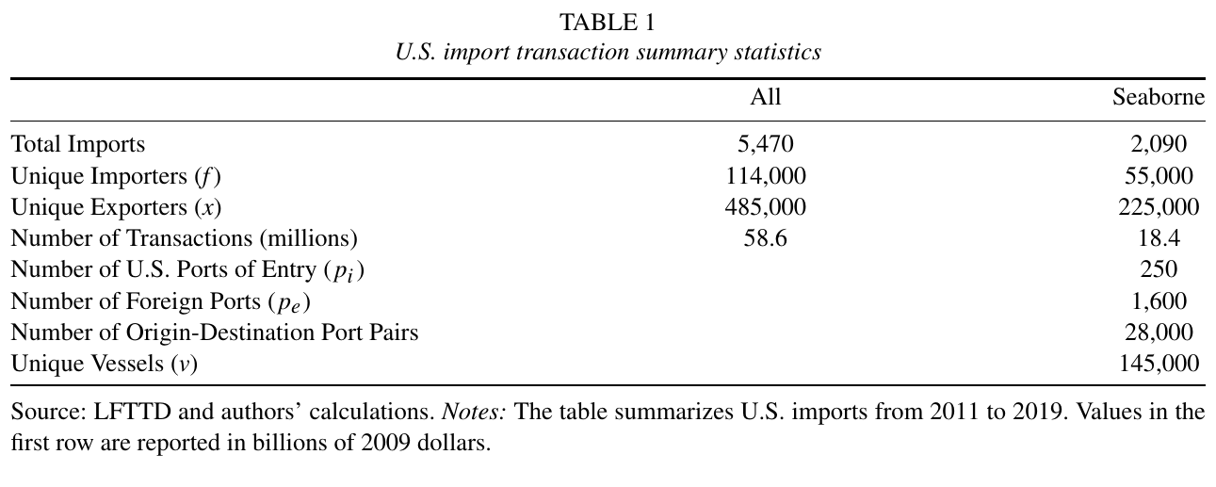
DATA AND EVIDENCE
Transaction-Level Data Link Ocean Shipping Risk to Manufacturers’ Operating Outcomes
Sample
U.S. manufacturing
2011–2019
Linkage
Shipments + firm records
Profit measure
Sales − materials − payroll
08 / 35
Notes:
Presenter notes (recommended: 50 seconds)
In the data section, start with the unit of observation rather than the regression coefficients. The image on the left is Table 1 from the paper, which distinguishes all manufacturing import transactions from ocean-shipping transactions. The study covers 2011–2019; the ocean-shipping descriptive sample contains about 18.4 million shipments, not the sample size for the sourcing regression in Table 6. The authors link LFTTD import transactions to the LBD business register, the Census of Manufactures, and annual surveys. Transaction records show who buys from whom, what is purchased, the route, and arrival timing; firm surveys provide sales, materials, payroll, and employment. This makes it possible to link shipping risk to firm performance and sourcing choices. Profit here means sales minus materials and payroll, not accounting net income. The next challenge is matching each shipment to the weather along its actual route.
Source: Paper, pp. 6–7, Table 1. Original image, including source notes.
Blaum, Esposito and Heise (2026), Input Sourcing under Climate Risk: Evidence from U.S. Manufacturing Firms, Review of Economic Studies, DOI 10.1093/restud/rdag031.
The English summary, comparisons, and policy extensions are the presenter’s synthesis; sources for original figures and equations are identified.

Slide 9
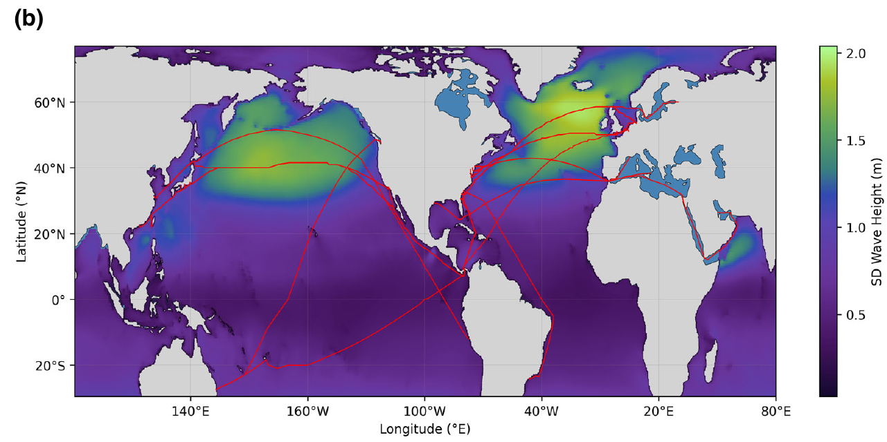
DATA AND EVIDENCE
Risk at the Same Destination Depends on the Route Actually Taken
Reconstruct
Vessel journeys and stops
Match
Weather along each route
Coverage limits
Inland legs and full
transshipment chains
09 / 35
Notes:
Presenter notes (recommended: 45 seconds)
The lower panel of Figure 2 shows the standard deviation of wave height: brighter colors indicate greater historical volatility, and the red line marks a selected route. It is not a regression result or a current shipping map; it illustrates why risk depends on the route actually taken. Knowing only the origin and destination does not fully characterize exposure along the way. The authors reconstruct about 331,000 detailed routes across roughly 14,000 route segments, then link weather along those routes to transactions. The origin-destination port pairs in Table 1 are not the same statistical unit as these detailed routes. Route reconstruction also has limits: inland legs at the beginning and end are not fully observed, and for transshipments the data mainly observe the final vessel. The map illustrates the measurement strategy; its colors alone do not identify firms’ causal responses.
Source: Paper, pp. 8–10, Figure 2(b), original panel. Colors show the standard deviation of wave height (m).
Blaum, Esposito and Heise (2026), Input Sourcing under Climate Risk: Evidence from U.S. Manufacturing Firms, Review of Economic Studies, DOI 10.1093/restud/rdag031.
The English summary, comparisons, and policy extensions are the presenter’s synthesis; sources for original figures and equations are identified.

Slide 10
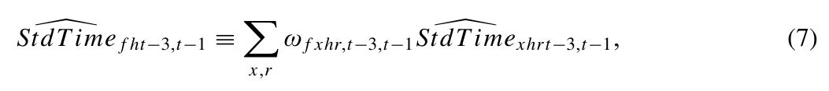
DATA AND EVIDENCE
Weather Shocks Isolate the Ex Ante Transit-Time Risk Faced by Firms
1 Estimate shipping time using route weather and controls
2 Extract the estimated weather component
3 Calculate its SD within supplier–product–route cells
4 Weight by import shares over the previous three years
Weighted exposure, not a portfolio variance. Non-vessel risk equals zero by construction.
10 / 35
Notes:
Presenter notes (recommended: 85 seconds)
Explain the four steps. First, the authors regress transaction-level shipping time on wave height along the route, relative direction, and their interactions, controlling for importer, product, exporter, route-month-year, vessel, and related-party fixed effects, as well as freight insurance and weight. Second, they retain only the shipping-time component explained by the wave terms; they do not call the full regression residual a weather shock. Third, they calculate a standard deviation over the previous three years within supplier-product-route cells, requiring at least 10 transactions. Fourth, they weight these cells by the firm’s import shares over the previous three years to obtain firm-product risk exposure. The figure shows Equation (7) from the paper. It is a weighted average of cell-level standard deviations, not a portfolio standard deviation that includes covariance. Setting risk for non-ocean shipments to zero is part of the paper’s measure and design; other transport modes can of course carry risk in reality. The wave-height coefficient in Table 3 is negative, so the weather term should not be interpreted as bad weather always causing delays; risk comes from variation in that component. The original Table 3 appears in the supplementary slides.
Source: Paper, pp. 11–12 and 15, Eqs. (3), (4), and (7). Equation (7) is shown as an original image.
Blaum, Esposito and Heise (2026), Input Sourcing under Climate Risk: Evidence from U.S. Manufacturing Firms, Review of Economic Studies, DOI 10.1093/restud/rdag031.
The English summary, comparisons, and policy extensions are the presenter’s synthesis; sources for original figures and equations are identified.

Slide 11
DATA AND EVIDENCE
Two Comparisons Separately Identify the Effects of Realized Delays and Ex Ante Risk
Question | Observation | Fixed effects
Realized delay and performance | Firm–year | Firm + year
Past risk and sourcing | Firm–product–year | Firm + product + year
The sourcing regression controls for mean shipping time, unit values and past firm size.
11 / 35
Notes:
Presenter notes (recommended: 70 seconds)
The paper asks two distinct empirical questions. The first concerns the relationship between realized extreme-weather delays and firm sales, profits, and employment, using firm-year observations with firm and year fixed effects. The second concerns historical transport risk and current sourcing, using firm-product-year observations. Equation (8) addresses the second question. The comparison is not simply the difference in means between high-risk and low-risk firms, and it is not a DID event study. The authors use panel variation in risk and control for firm, product, and year fixed effects, as well as mean weather-related transit time, unit values, and firm size. The baseline includes these three fixed effects separately, not firm-product fixed effects, and is not 2SLS. It also excludes firm-product combinations with a single current supplier. Historical weights reduce concerns about reverse causality but still reflect past sourcing choices. State this boundary before presenting the results.
Source: Paper, pp. 13–16, Eqs. (6) and (8). Equation (8) is shown as an original image.
Blaum, Esposito and Heise (2026), Input Sourcing under Climate Risk: Evidence from U.S. Manufacturing Firms, Review of Economic Studies, DOI 10.1093/restud/rdag031.
The English summary, comparisons, and policy extensions are the presenter’s synthesis; sources for original figures and equations are identified.

Slide 12
DATA AND EVIDENCE
One-SD delay exposure: sales −5.3%, profits −3.5%, employment −0.9%
Outcome | Coefficient on delayed share | SE | One-SD approximation
Sales | −2.617*** | (0.303) | −5.3%
Profits | −1.728*** | (0.352) | −3.5%
Employment | −0.452*** | (0.163) | −0.9%
One SD of delayed-share exposure = 2.02 percentage points. Mean exposure = 0.30%.
Comparison: the same firm across years, net of common year shocks.
12 / 35
Notes:
Presenter notes (recommended: 70 seconds)
Start with the comparison: the same firm experiences different levels of extreme-weather delays across years, with firm and year fixed effects included. An extreme delay is defined as weather-related transit time above the 95th percentile within a product-route. The exposure share is the value of delayed imports divided by materials and labor costs. The coefficients in the table are not percentages by themselves. Raising exposure by one standard deviation—2.02 percentage points—implies the approximate changes reported in the paper: sales fall 5.3%, profits 3.5%, and employment 0.9%. Profit means sales minus materials and payroll, not accounting net income. This result establishes that shipping delays have real operating consequences and motivates the analysis of ex ante risk.
Source: Paper, pp. 12–14, Table 4. Firm and year fixed effects; standard errors clustered by firm.
Blaum, Esposito and Heise (2026), Input Sourcing under Climate Risk: Evidence from U.S. Manufacturing Firms, Review of Economic Studies, DOI 10.1093/restud/rdag031.
The English summary, comparisons, and policy extensions are the presenter’s synthesis; sources for original figures and equations are identified.

Slide 13
DATA AND EVIDENCE
P25 to P75 risk: routes +9.0%, suppliers +5.9%, imports −4.3%
Dependent variable | Routes | Suppliers | Route HHI | Supplier HHI | Imports
Risk elasticity | 0.177*** | 0.116*** | −0.089*** | −0.072*** | −0.085***
P25 to P75 | +9.0% | +5.9% | −4.5% | −3.7% | −4.3%
Broader sourcing
Lower concentration
Lower import demand
Risk remains significant after controlling for mean weather-related shipping time.
13 / 35
Notes:
Presenter notes (recommended: 85 seconds)
This is the paper’s central empirical slide. First clarify the comparison: at the firm-product-year level, the authors relate changes in historical transport risk to current sourcing choices. Risk and outcomes are in logs. The regressions control for firm, product, and year fixed effects, mean transit time, mean unit value, and firm size. Read the five columns in order: number of routes, number of suppliers, route HHI, supplier HHI, and total imports. Risk rises by about 0.51 log points from the 25th to the 75th percentile. Routes increase by about 9.0%, suppliers by 5.9%, both HHI measures decline, and total import value falls by 4.3%. Risk remains significant after controlling for mean transit time, distinguishing “slow” from “unreliable.” Historical weights mitigate reverse-causality concerns but do not eliminate every sourcing-selection issue.
Source: Paper, pp. 15–16, Table 6. Log outcomes; firm, product, and year fixed effects.
Blaum, Esposito and Heise (2026), Input Sourcing under Climate Risk: Evidence from U.S. Manufacturing Firms, Review of Economic Studies, DOI 10.1093/restud/rdag031.
The English summary, comparisons, and policy extensions are the presenter’s synthesis; sources for original figures and equations are identified.

Slide 14
DATA AND EVIDENCE
Higher sea-shipping risk also raises the probability of using air freight
Outcome | Risk coefficient | P25 to P75 implication
Uses air shipping: 0 or 1 | 0.032*** | About +1.6 percentage points
The response extends beyond suppliers and routes to the mode of transport.
Interpret 1.6 as percentage points, not a 1.6% relative increase.
14 / 35
Notes:
Presenter notes (recommended: 45 seconds)
This slide presents a third firm response; there is no need to read the full table. The outcome is an indicator for whether the firm air-ships a given HS10 product. The risk coefficient is 0.032. Multiplying it by the 0.51 log-point change in risk from the 25th to the 75th percentile implies an increase of about 1.6 percentage points in the probability of air shipping. This is a percentage-point change, not a 1.6% relative increase. Firms also adjust transport mode, but this does not show that air shipping is risk-free or suitable for every firm. The full table is in the appendix.
Source: Paper, p. 18, Table 7. The dependent variable equals one when a firm uses air shipping.
Blaum, Esposito and Heise (2026), Input Sourcing under Climate Risk: Evidence from U.S. Manufacturing Firms, Review of Economic Studies, DOI 10.1093/restud/rdag031.
The English summary, comparisons, and policy extensions are the presenter’s synthesis; sources for original figures and equations are identified.

Slide 15
DATA AND EVIDENCE
The empirical pattern is adaptation with contraction, not simple trade expansion
Margin | Observed response | Economic meaning
Sourcing breadth | More routes and suppliers | Diversification
Spending concentration | Lower route and supplier HHI | Purchases spread more widely
Import scale | Lower total import value | Foreign-input contraction
Transport mode | Higher probability of air shipping | Costly alternative to sea freight
Theory must explain why diversification and contraction occur together.
15 / 35
Notes:
Presenter notes (recommended: 45 seconds)
Use this slide to close the empirical section and motivate the theory. Firms adapt by adding routes, suppliers, and air shipping, while reducing spending concentration. At the same time, total import value falls. Diversification therefore cannot be equated with an expansion of globalization, and supplier counts alone are not a sufficient measure of resilience. The next section explains two things: why risk-neutral firms care about transit-time volatility, and why a larger number of sources does not result in higher total imports.
Source: Paper, pp. 15–18, Tables 6–7. Synthesis by the presenter.
Blaum, Esposito and Heise (2026), Input Sourcing under Climate Risk: Evidence from U.S. Manufacturing Firms, Review of Economic Studies, DOI 10.1093/restud/rdag031.
The English summary, comparisons, and policy extensions are the presenter’s synthesis; sources for original figures and equations are identified.

Slide 16
THEORY
Firms choose sources and orders before shipping uncertainty is realized
Stage | Information and choices
Before delivery | Choose domestic inputs, foreign orders and number of sources N
Uncertainty realizes | Shipping days determine effective input quality
After delivery | Choose labor, produce and sell
Firms know the distribution of shipping times when ordering.
16 / 35
Notes:
Presenter notes (recommended: 55 seconds)
Clarify the timing of sourcing decisions. Firms know the distribution of transit times ex ante but do not know the exact arrival time of a particular shipment. Before uncertainty is realized, they choose domestic inputs, order quantities from each foreign source, and the number of sources, and pay fixed costs. Transit times are then realized, determining effective input quality. Firms finally choose labor, produce, and sell. Thus, the model does not assume that firms can instantly replace all inputs after a shipment is late. Ex ante preparation is costly, and ex post labor adjustments cannot eliminate all losses from missing inputs. Firms are risk-neutral in the model, but risk still affects expected profits; the next slide explains why.
Source: Paper, pp. 19–21, Sections 4.1–4.2. Model timing.
Blaum, Esposito and Heise (2026), Input Sourcing under Climate Risk: Evidence from U.S. Manufacturing Firms, Review of Economic Studies, DOI 10.1093/restud/rdag031.
The English summary, comparisons, and policy extensions are the presenter’s synthesis; sources for original figures and equations are identified.

Slide 17
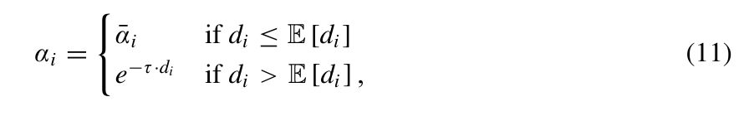
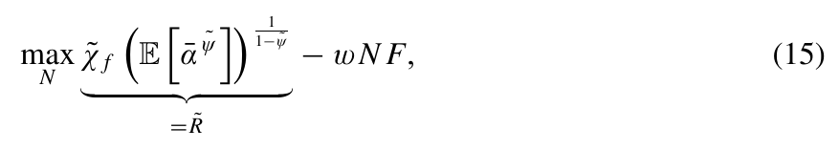
THEORY
Late delivery lowers effective input quality, and concavity makes volatility costly
Late delivery
Concavity
Effective input quality falls only after the expected delivery time.
With 0 < ψ̃ < 1, greater quality variance lowers expected returns.
Independent sources: Var(average quality) = Var(source quality) / N
17 / 35
Notes:
Presenter notes (recommended: 100 seconds)
Start with the quality function. When an input arrives on time or early, its effective quality remains at the baseline. After a delay, effective quality declines exponentially with transit time. Quality here means the input’s effective value in production, not necessarily physical damage. Then explain concavity. Even a risk-neutral firm’s expected profit depends on a concave function of mean effective quality, so greater volatility lowers expected returns when the mean is held fixed. If sources are independent, the variance of average quality equals single-source quality variance divided by N; adding sources therefore provides insurance. This intuition depends on three conditions: source independence, a fixed mean, and concavity generated by production and demand.
Source: Paper, pp. 19–21, Eqs. (11) and (15). Original equation images.
Blaum, Esposito and Heise (2026), Input Sourcing under Climate Risk: Evidence from U.S. Manufacturing Firms, Review of Economic Studies, DOI 10.1093/restud/rdag031.
The English summary, comparisons, and policy extensions are the presenter’s synthesis; sources for original figures and equations are identified.

Slide 18
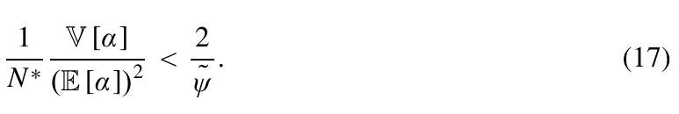
THEORY
Risk can raise the number of sources while reducing total imports
Force | Effect on N and imports
Insurance effect | Higher risk raises the value of an additional source
Scale effect | Lower expected returns shrink orders and the value of sourcing
Under Eq. (17): N rises, but its risk elasticity stays below 1. Total imports fall.
18 / 35
Notes:
Presenter notes (recommended: 90 seconds)
Higher risk creates two forces. The insurance effect raises the value of adding sources, while the scale effect lowers the return to another source because expected revenue falls. Under the condition in Equation (17), the insurance effect dominates and the optimal number of sources N rises. The authors also show that, in a simplified second-order approximation, the elasticity of N with respect to quality variance is below one. The number of sources therefore rises less than risk does. Total imports equal the foreign-input price times N times the order per source, x. Firms divide a smaller total order across more sources and pay more fixed costs, so total imports decline. This proposition is conditional; do not present it as a universal result that risk always increases supplier counts.
Source: Paper, pp. 21–22, Proposition 1 and Eq. (17). Original equation image.
Blaum, Esposito and Heise (2026), Input Sourcing under Climate Risk: Evidence from U.S. Manufacturing Firms, Review of Economic Studies, DOI 10.1093/restud/rdag031.
The English summary, comparisons, and policy extensions are the presenter’s synthesis; sources for original figures and equations are identified.

Slide 19
QUANTITATIVE ANALYSIS
Calibration matches the sourcing response, but not every empirical magnitude
Moment | Model | Data | Role
N elasticity to risk | 0.18 | 0.18 | Targeted
Sales elasticity to shipping time | −0.14 | −0.27 | Targeted
Import share | 0.28 | 0.28 | Targeted
SD of log sales | 0.21 | 0.22 | Targeted
Corr(log sales, risk) | −0.22 | −0.26 | Targeted
Import elasticity to risk | −0.16 | −0.09 | Not targeted
The model matches the direction of the untargeted import response, but overstates its magnitude.
19 / 35
Notes:
Presenter notes (recommended: 75 seconds)
Distinguish targeted moments from an untargeted check. The fixed cost F helps match the elasticity of source counts to risk; it is 0.18 in both the model and data. Sensitivity of quality to transit time helps match the sales elasticity with respect to transit time, but the model estimate is −0.14 versus −0.27 in the data, so they do not fully align. The foreign-input price is chosen to match an import share of 0.28. The distribution of firm efficiency and its correlation with risk are chosen to match the sales distribution. The import elasticity to risk is not directly targeted: it is −0.16 in the model and −0.09 in the data. The signs agree, but the magnitude differs. The model is therefore a conditional quantitative laboratory, not a precise fit to every empirical moment.
Source: Paper, pp. 24–26, Table 8. Selected targets and one untargeted moment.
Blaum, Esposito and Heise (2026), Input Sourcing under Climate Risk: Evidence from U.S. Manufacturing Firms, Review of Economic Studies, DOI 10.1093/restud/rdag031.
The English summary, comparisons, and policy extensions are the presenter’s synthesis; sources for original figures and equations are identified.

Slide 20
QUANTITATIVE ANALYSIS
Three counterfactuals change risk while holding mean input quality fixed
Scenario | Risk change | Mapping
Climate trend | +18.5% | 50-year extrapolation of wave volatility
Port congestion | +52% | Higher dispersion in port waiting times
Removing risk | Zero shipping risk | A benchmark for the value of reliability
All counterfactuals hold mean input quality constant.
20 / 35
Notes:
Presenter notes (recommended: 60 seconds)
The authors construct two scenarios that raise risk and one benchmark that removes it. The climate scenario uses the average annual growth rate of wave-height standard deviation along routes from 2011 to 2023, about 0.34%. Extrapolating the historical trend for 50 years gives an 18.5% increase, which is mapped into shipping-time risk under a stable relationship between weather and transit time. The port scenario uses waiting-time data from January 2017 to June 2024. The standard deviation in 2021–2022 was 52% higher than in other periods; that increase is introduced as a risk shock in the model. The third scenario removes shipping risk entirely. Footnote 29 is important: these counterfactuals hold mean input quality fixed, isolating the spread in quality risk. They are model scenarios, not unconditional climate forecasts or regression-identified effects of a port event. Real events may also change means, costs, and correlations and require separate analysis.
Source: Paper, pp. 26–27, Sections 5.2.1–5.2.2 and footnote 29. Conditional model scenarios.
Blaum, Esposito and Heise (2026), Input Sourcing under Climate Risk: Evidence from U.S. Manufacturing Firms, Review of Economic Studies, DOI 10.1093/restud/rdag031.
The English summary, comparisons, and policy extensions are the presenter’s synthesis; sources for original figures and equations are identified.

Slide 21
QUANTITATIVE ANALYSIS
Adaptation does not remove losses: real income falls 0.5%–1.1%
Outcome | Climate risk | Port congestion | Removing risk
Average N | +18.58% | +31.86% | −11.06%
Total import value | −1.32% | −2.83% | +5.21%
Real income | −0.49% | −1.13% | +2.27%
Firms diversify in the first two scenarios, yet imports and real income still fall.
Removing risk reduces the need for insurance sources and raises real income by 2.27%.
21 / 35
Notes:
Presenter notes (recommended: 90 seconds)
Read the figure in three layers: firm behavior, trade, and welfare. In the climate-risk scenario, the average number of sources rises by 18.58%; under port congestion, it rises by 31.86%, showing active adaptation. Yet total imports fall by 1.32% and 2.83%, and real income falls by 0.49% and 1.13%, respectively. When risk is removed, firms no longer need as many insurance sources: average N falls by 11.06%, imports rise by 5.21%, and real income rises by 2.27%. The three measures have different units, so focus on labels and direction rather than comparing bar heights on a common visual scale. These are conditional model results for U.S. manufacturing, not GDP forecasts.
Source: Paper, p. 27, Table 9. All entries are percentage changes.
Blaum, Esposito and Heise (2026), Input Sourcing under Climate Risk: Evidence from U.S. Manufacturing Firms, Review of Economic Studies, DOI 10.1093/restud/rdag031.
The English summary, comparisons, and policy extensions are the presenter’s synthesis; sources for original figures and equations are identified.

Slide 22
QUANTITATIVE ANALYSIS
Fixed costs, domestic substitution and price feedback leave a residual loss
Channel | Economic implication
Costly diversification | More sources require fixed costs
Domestic substitution | Less risky inputs may sacrifice sourcing efficiency
Price feedback | Domestic input and final-good prices respond
Real purchasing power | Profits and prices determine remaining income losses
Quantitative results depend on model substitution and risk assumptions.
22 / 35
Notes:
Presenter notes (recommended: 80 seconds)
Why do losses remain after firms adapt? First, diversification has fixed costs, and the optimal response in N is not large enough to eliminate the added risk. Second, reducing foreign inputs and switching to domestic inputs changes costs. Domestic inputs and final goods share a price index, so risk feeds back into prices through domestic production linkages. Consumer income comes from labor and profits; dividing by the price index gives real purchasing power. In the model, PC equals wage income plus total profits, so real income is not total domestic expenditure S itself. The quantitative model extends the simplified proposition by adding domestic inputs, firm heterogeneity, and general equilibrium. It retains important limits: no aggregate labor-market clearing, normalized wages, no direct modeling of exports, final-good imports, or nontraded goods, independent source risks, and safe domestic sourcing. These assumptions bound external validity. Firms’ optimal adjustments can reduce harm without restoring the whole economy at zero cost.
Source: Paper, pp. 21–23 and 27. Household budget: PC = wL + Π. Domestic input price pD = P.
Blaum, Esposito and Heise (2026), Input Sourcing under Climate Risk: Evidence from U.S. Manufacturing Firms, Review of Economic Studies, DOI 10.1093/restud/rdag031.
The English summary, comparisons, and policy extensions are the presenter’s synthesis; sources for original figures and equations are identified.

Slide 23
IMPLICATIONS
Source counts overstate resilience when suppliers share bottlenecks
Observed diversity | Shared bottleneck to check
More suppliers | Common production region or input source
More routes | Common port, canal or shipping infrastructure
More transport modes | Cost, capacity and substitution constraints
A useful metric is effective risk reduction per unit of adaptation cost.
23 / 35
Notes:
Presenter notes (recommended: 65 seconds)
Return to the case by asking how to measure effective diversification. A firm may buy from several suppliers that share the Suez Canal, a port, or a shipping arrangement; diversification by name is not necessarily diversification of risk. The paper’s risk measure is a weighted average of standard deviations, and its model assumes independent sources. Neither fully captures common exposure across sources. Future work could model multilayer links among suppliers, ports, routes, and transport modes. In a teaching extension with equal variances and equal weights, higher source correlation reduces the benefit of increasing N. This is not an estimated result in the paper and should not be presented as a mechanism the authors have established. The management implication is to compare effective risk reduction with coordination costs; the finance implication is to account for correlations across sources. The research question is which sourcing portfolios still provide insurance when bottlenecks are shared.
Source: Presenter interpretation; Paper, pp. 15 and 19–22. Correlated-risk extension is outside the paper.
Blaum, Esposito and Heise (2026), Input Sourcing under Climate Risk: Evidence from U.S. Manufacturing Firms, Review of Economic Studies, DOI 10.1093/restud/rdag031.
The English summary, comparisons, and policy extensions are the presenter’s synthesis; sources for original figures and equations are identified.

Slide 24
IMPLICATIONS
Diversification, reshoring and infrastructure require the same cost-benefit test
Option | Benefit to evaluate | Cost or limit
Diversification | Lower effective supply risk | Fixed and coordination costs
Reshoring | Lower exposure to foreign disruption | Domestic risk and efficiency trade-off
Infrastructure | More reliable delivery and capacity | Investment cost and shared benefits
Compare reliability gains with full economic costs.
24 / 35
Notes:
Presenter notes (recommended: 65 seconds)
A decline in imports alone does not show that reshoring policy has succeeded. In the paper, firms reduce high-risk foreign inputs and increase domestic inputs, yet prices and real-income losses remain. This mechanism suggests comparing risks, prices, and substitutability at home and abroad. Domestic supply is not necessarily risk-free, and critical inputs may not be replaceable. The port scenario shows that reliability has economic value, but the 2.27% income gain from removing all risk is not the return on any specific port investment. Construction, spare capacity, and digital scheduling all require evaluation of costs, the actual risk reduction, and social benefits. For diversification, the goal is not to maximize source counts but to compare insurance benefits with fixed costs. The paper offers an evaluation framework; it does not directly establish which subsidy or reshoring policy is optimal.
Source: Presenter policy discussion, not an optimal-policy result of this paper. Paper, pp. 26–28.
Blaum, Esposito and Heise (2026), Input Sourcing under Climate Risk: Evidence from U.S. Manufacturing Firms, Review of Economic Studies, DOI 10.1093/restud/rdag031.
The English summary, comparisons, and policy extensions are the presenter’s synthesis; sources for original figures and equations are identified.

Slide 25
SELF-ASSESSMENT · 1 / 2
The Paper Builds a Complete Evidence Chain from Measurement to Behavior, Mechanisms, and Welfare
Contribution | Evidence in the paper | Research value
Measurement innovation | Transaction-level customs data + route reconstruction + wave data | Turns arrival uncertainty into a reproducible firm-level risk measure
Comprehensive empirical evidence | Risk affects five sourcing margins even after controlling for mean transit time | Identifies “diversification with contraction”
Theory and quantification | Heterogeneous-firm import model + general-equilibrium counterfactuals | Explains why N rises while imports fall, and estimates welfare losses
Literature connections | Time costs, sourcing margins, supply-chain disruptions, and resilience policy | Advances research on risk in input sourcing
Its distinctive contribution is that all four components can be tested against one another, rather than relying on any single result.
26 / 36
Notes:
Presenter notes (recommended: 150 seconds)
This slide takes about two and a half minutes. First, the measurement contribution: the authors combine transaction-level customs records, reconstructed routes, and wave data to turn hard-to-observe delivery uncertainty into a reproducible firm-product risk measure. Second, the empirical evidence is comprehensive: after controlling for mean transit time, risk still affects route counts, supplier counts, two measures of concentration, import value, and air-shipping probability. The key fact is the coexistence of diversification and contraction. Third, theory and quantification form a loop. Random arrivals, effective quality, and fixed source costs explain why N rises while imports fall; general-equilibrium counterfactuals then quantify welfare losses from climate risk and port congestion. Fourth, the paper connects four strands—trade time, sourcing margins, supply-chain disruptions, and resilience policy—and shifts attention toward day-to-day risk on the input-sourcing side.
Source: Presenter assessment based on the main paper, pp. 4–28.
Blaum, Esposito and Heise (2026), Input Sourcing under Climate Risk: Evidence from U.S. Manufacturing Firms, Review of Economic Studies, DOI 10.1093/restud/rdag031.
The English summary, comparisons, and policy extensions are the presenter’s synthesis; sources for original figures and equations are identified.

Slide 26
SELF-ASSESSMENT · 2 / 2
Identification, Risk Correlation, and Model Extrapolation Require Caution
Concern | What remains open | Why it matters
Risk measurement | Equation (7) is a weighted standard deviation, not a portfolio variance; shared ports and shipping lanes are not fully captured | More sources may represent only superficial diversification
Weather exogeneity | Weather may also affect ports, demand, and production; non-ocean risks are set to zero, and only the final leg is observed | Other channels and measurement omissions may affect the interpretation
Model assumptions | Suppliers are ex ante identical; transit times are i.i.d.; domestic inputs are safe; inventories and financial hedging are absent | Mechanisms and welfare results depend on substitution patterns and calibration
Quantitative extrapolation | Untargeted elasticity: −0.16 in the model and −0.09 in the data; the sample covers U.S. manufacturing from 2011 to 2019 | The estimates cannot be directly extrapolated to COVID-19, the Red Sea, or China’s institutional environment
27 / 36
Notes:
Presenter notes (recommended: 150 seconds)
This slide also takes about two and a half minutes. First, Equation (7) is a historical-share-weighted average of cell-level standard deviations, not portfolio risk with covariance. If suppliers share ports, canals, or shipping lanes, more sources may amount only to superficial diversification. Second, weather exogeneity remains open to scrutiny. Weather may also affect port efficiency, demand, and production. Route-month fixed effects absorb seasonality but may not rule out every channel. Setting non-ocean risk to zero and observing mainly the last vessel in transshipment chains may understate total risk. Third, the model makes strong assumptions: suppliers are identical ex ante, transit times are i.i.d., domestic inputs are safe, and inventories, financing constraints, and policy instruments are absent. Fourth, quantitative extrapolation should be cautious. The untargeted import-risk elasticity is −0.16 in the model versus −0.09 in the data, so the model overstates the response. The 2011–2019 U.S. manufacturing sample does not include COVID-19 or Red Sea shocks, and China has a different substitution capacity and institutional environment.
Source: Presenter’s reviewer-style assessment based on the paper’s risk measure, identification design, and model assumptions.
Blaum, Esposito and Heise (2026), Input Sourcing under Climate Risk: Evidence from U.S. Manufacturing Firms, Review of Economic Studies, DOI 10.1093/restud/rdag031.
The English summary, comparisons, and policy extensions are the presenter’s synthesis; sources for original figures and equations are identified.

Slide 27
国际贸易专题研究
谢谢大家！
恳请大家批评指正！
汇报人：2026级应用经济学 姜琳
2026年10月13日
Notes:
今天讨论一个看似属于物流管理、实际贯穿贸易、金融和农业的问题：如果投入品平均仍然十九天到货，但到货时间越来越不稳定，企业会怎样调整采购？这篇论文的贡献是把航运风险测量、企业采购反应和总体经济后果连成一个可以检验的框架。报告依据大家提供的三十页正式期刊版，2026年5月14日在线发表。我的评价和教学例子会单独标识，避免把研究启发当作作者已经证明的结论。
依据：主文正式期刊版，第1页｜Blaum、Esposito、Heise（2026）
计划时长：31秒

Slide 28
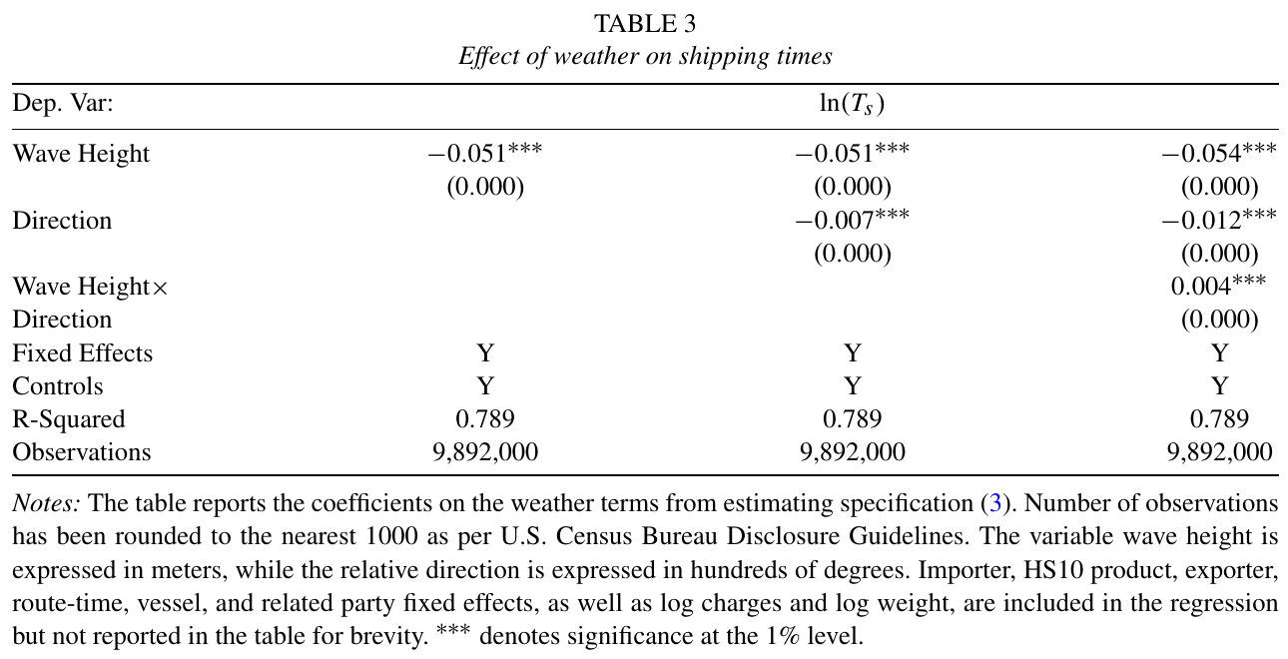
SUPPLEMENTARY EVIDENCE
Appendix: weather terms predict shipping-time variation
Reading the table
Wave height coefficient < 0
Risk measure
Weather-induced
time variation
R-squared
Includes fixed effects
27 / 35
Notes:
Presenter notes (Q&A only; suggested speaking time: 0 seconds)
This is the reference Table 3. The wave-height coefficient is negative; relative direction and interaction terms also enter the weather component, so high waves should not mechanically be equated with slower shipping. The authors suggest that vessels may travel faster in adverse areas and report a similar result using satellite data. The total R-squared includes fixed effects; it does not mean weather alone explains 78.9% of shipping-time variation. The appendix reports the satellite check; it was not independently re-estimated for this presentation.
Source: Paper, p. 12, Table 3. Original image with notes.
Blaum, Esposito and Heise (2026), Input Sourcing under Climate Risk: Evidence from U.S. Manufacturing Firms, Review of Economic Studies, DOI 10.1093/restud/rdag031.
The English summary, comparisons, and policy extensions are the presenter’s synthesis; sources for original figures and equations are identified.

Slide 29
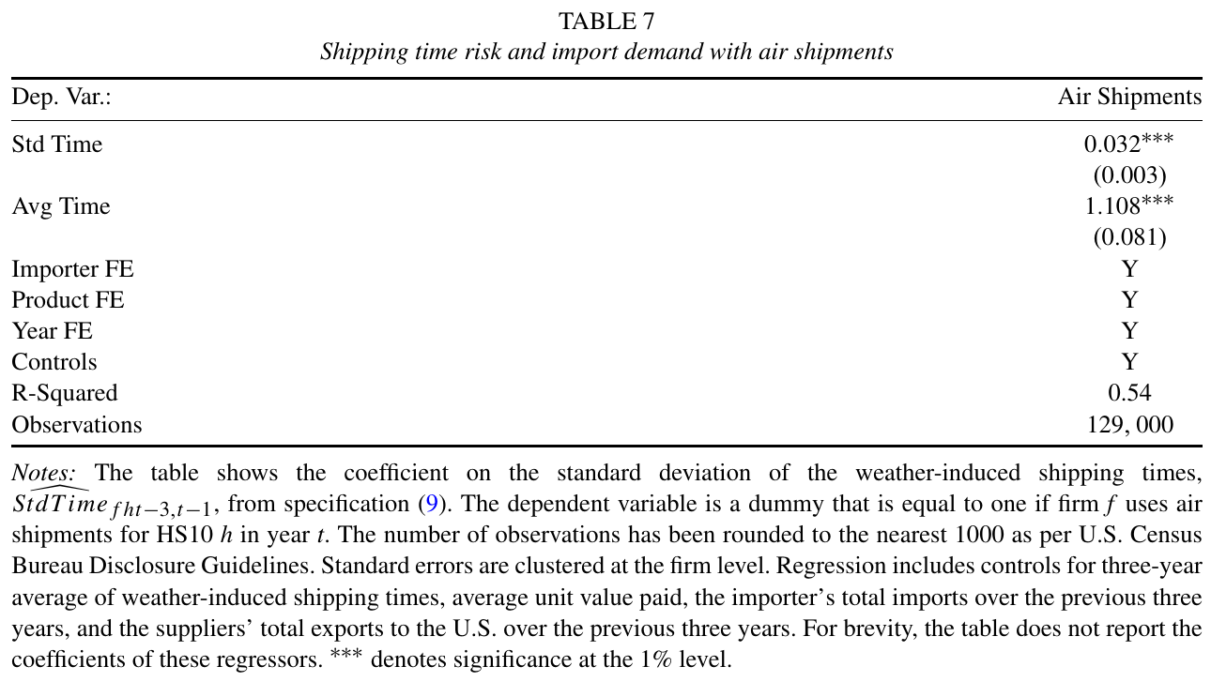
SUPPLEMENTARY EVIDENCE
Appendix: risk also raises the use of air shipping
Outcome
Uses air shipping: 0 or 1
Risk coefficient
0.032
P25 to P75 change
About +1.6 percentage points
28 / 35
Notes:
Presenter notes (Q&A only; suggested speaking time: 0 seconds)
In Table 7, the dependent variable is an indicator for whether air shipping is used, and the risk regressor is in logs. The risk coefficient, 0.032, multiplied by the 0.51 log-point change in risk across percentiles, is about 0.0163, or 1.6 percentage points—not a 1.6% relative increase in the probability of air shipping. This shows adjustment in transport mode but does not establish that air shipping is risk-free in practice or should be used by every firm.
Source: Paper, p. 18, Table 7. Original image with notes. Probability change is in percentage points.
Blaum, Esposito and Heise (2026), Input Sourcing under Climate Risk: Evidence from U.S. Manufacturing Firms, Review of Economic Studies, DOI 10.1093/restud/rdag031.
The English summary, comparisons, and policy extensions are the presenter’s synthesis; sources for original figures and equations are identified.

Slide 30
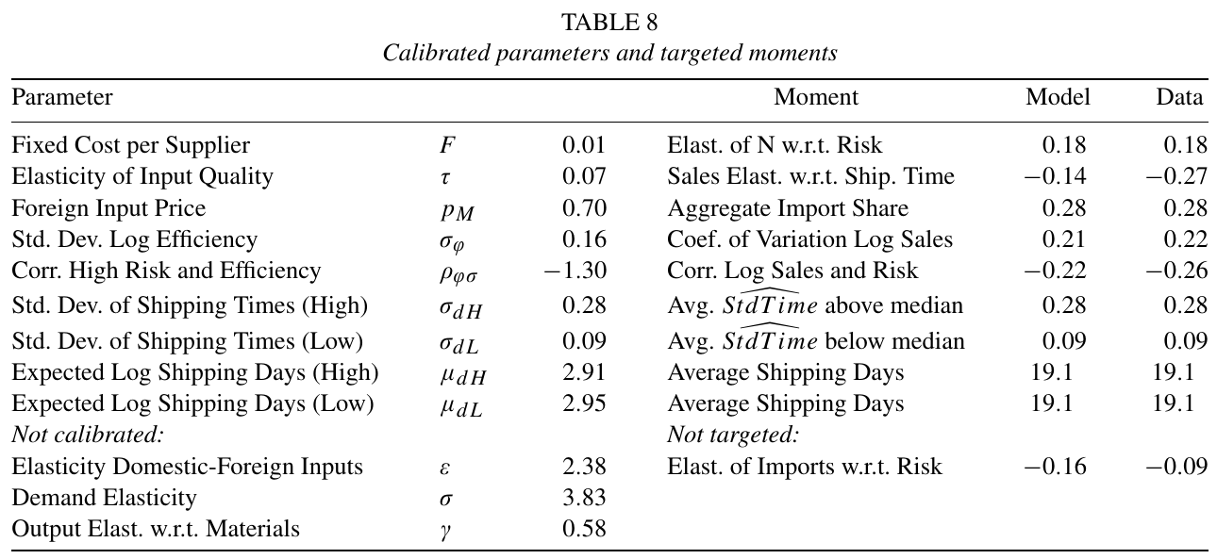
APPENDIX
Appendix: calibration parameters and targeted moments
Targets cover sourcing, time sensitivity, import shares and firm heterogeneity.
29 / 35
Notes:
Presenter notes (Q&A only; suggested speaking time: 0 seconds)
Use the complete Table 8 for questions. Distinguish the moments used to choose parameters from the untargeted outcomes. In particular, do not treat the source elasticity of 0.18 as a fully independent model validation.
Source: Paper, pp. 24–26, Table 8. Original table body; full notes are in the speaker notes.
Blaum, Esposito and Heise (2026), Input Sourcing under Climate Risk: Evidence from U.S. Manufacturing Firms, Review of Economic Studies, DOI 10.1093/restud/rdag031.
The English summary, comparisons, and policy extensions are the presenter’s synthesis; sources for original figures and equations are identified.

Slide 31
APPENDIX
Appendix: Proposition 1 has an explicit sufficient condition
Force | Effect on optimal N
Insurance benefit | Higher risk raises the value of diversification
Scale effect | Lower expected revenue reduces the return to adding sources
Under Eq. (17), N rises. Its elasticity to quality variance remains below 1.
30 / 35
Notes:
Presenter notes (Q&A only; suggested speaking time: 0 seconds)
Proposition 1 explains why the number of sources may rise and states the conditions. Higher quality risk creates two opposing forces. The insurance force is that more sources reduce the variance of average quality, making diversification more valuable as risk rises. The scale force is that risk lowers expected returns and firm scale, reducing the payoff from adding sources. Under Equation (17), the insurance force dominates and N rises. The condition is that the coefficient of variation of optimal mean quality is not too large. In the simplified second-order approximation, the authors also show that the elasticity of N with respect to quality variance is below one. Thus N may rise without keeping pace with the increase in each source’s variance; residual risk still rises and imports fall. Do not claim that risk increases supplier counts in every setting. The empirical analysis measures the standard deviation of transit time, while the proposition concerns quality variance, so the full quantitative model must establish the mapping from transit time to quality.
Source: Paper, p. 22, Proposition 1 and Eq. (17). Original equation image; second-order approximation with continuous N.
Blaum, Esposito and Heise (2026), Input Sourcing under Climate Risk: Evidence from U.S. Manufacturing Firms, Review of Economic Studies, DOI 10.1093/restud/rdag031.
The English summary, comparisons, and policy extensions are the presenter’s synthesis; sources for original figures and equations are identified.

Slide 32
APPENDIX
Appendix: four claims the paper does not establish
Misreading | Accurate interpretation
Higher waves always delay ships | Weather terms jointly generate time variation; the wave-height coefficient is negative
The risk index is portfolio variance | It is a weighted average of cell-level standard deviations
More suppliers mean more trade | Source counts rise while total import value falls
2.27% is infrastructure ROI | It is the model gain from removing all shipping risk
31 / 35
Notes:
Presenter notes (Q&A only; suggested speaking time: 0 seconds)
Four common misreadings: First, the wave-height coefficient is negative, so bad weather should not be described simply as slower shipping. Second, the risk measure is a weighted average of standard deviations and excludes cross-source covariance. Third, more suppliers do not imply more imports. Fourth, the 2.27% income gain from removing all risk is not the return on a specific port investment.
Source: Presenter’s reading boundaries based on the paper, pp. 11–28.
Blaum, Esposito and Heise (2026), Input Sourcing under Climate Risk: Evidence from U.S. Manufacturing Firms, Review of Economic Studies, DOI 10.1093/restud/rdag031.
The English summary, comparisons, and policy extensions are the presenter’s synthesis; sources for original figures and equations are identified.

Slide 33
APPENDIX
Appendix: a reviewer would probe identification and external validity
Reviewer question | Why it matters
Does weather affect ports, demand or production directly? | Challenges exclusion and interpretation of the weather component
Do historical sourcing weights encode unobserved selection? | Affects the causal interpretation of risk exposure
How much error enters supplier IDs and reconstructed routes? | Measurement error may attenuate or reshape coefficients
Are risks independent and domestic inputs safe? | Determines how far diversification and welfare results travel
32 / 35
Notes:
Presenter notes (Q&A only; suggested speaking time: 0 seconds)
Reviewer questions center on four issues: Does weather also affect ports, demand, or production? Do historical sourcing weights reflect unobserved selection? How do supplier identifiers and route-reconstruction errors affect the risk measure? Do source-independence and safe-domestic-sourcing assumptions hold when bottlenecks are shared? In discussion, distinguish robustness checks already in the paper from extensions that remain open.
Source: Presenter’s reviewer assessment based on the empirical design and model assumptions.
Blaum, Esposito and Heise (2026), Input Sourcing under Climate Risk: Evidence from U.S. Manufacturing Firms, Review of Economic Studies, DOI 10.1093/restud/rdag031.
The English summary, comparisons, and policy extensions are the presenter’s synthesis; sources for original figures and equations are identified.

Slide 34
APPENDIX
Appendix: the paper sits between trade time, sourcing and network shocks
Question | Selected formal journal articles
Time as a trade barrier | Evans & Harrigan (2005, AER); Hummels & Schaur (2013, AER)
Global sourcing margins | Antràs, Fort & Tintelnot (2017, AER); Blaum, Lelarge & Peters (2018, AEJ Macro)
Supply-chain shocks | Barrot & Sauvagnat (2016, QJE); Carvalho et al. (2021, QJE); Alessandria et al. (2023, JIE)
Resilience choices | Grossman, Helpman & Lhuillier (2023, JPE); Blaum, Esposito & Heise (2026, ReStud)
33 / 35
Notes:
Presenter notes (Q&A only; suggested speaking time: 0 seconds)
Use this slide if the audience asks about related literature. Organize the answer by question rather than listing papers one by one. Trade-time research studies average delivery costs; global-sourcing research studies source margins; supply-chain-shock research studies propagation of major disruptions. This paper brings frequent transport risk into sourcing choices and aggregate quantification.
Source: Selected formal journal articles cited in the paper and in the reading list.
Blaum, Esposito and Heise (2026), Input Sourcing under Climate Risk: Evidence from U.S. Manufacturing Firms, Review of Economic Studies, DOI 10.1093/restud/rdag031.
The English summary, comparisons, and policy extensions are the presenter’s synthesis; sources for original figures and equations are identified.

Slide 35
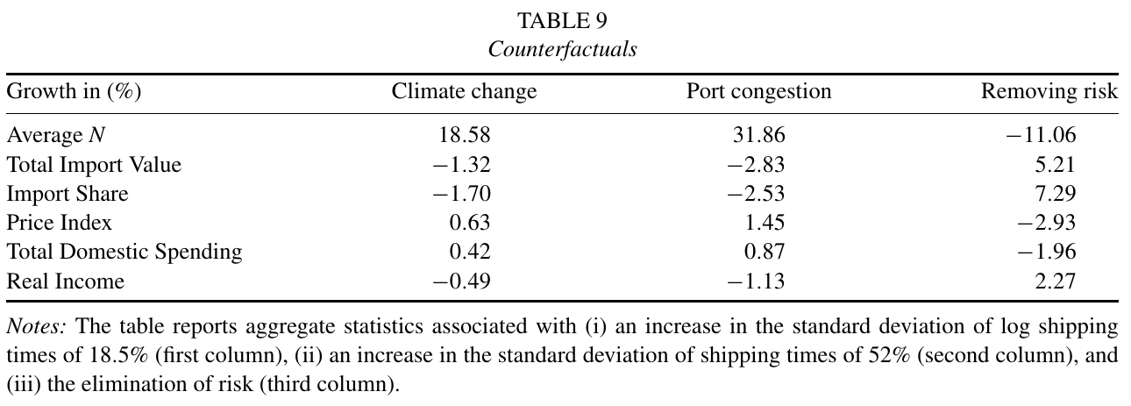
APPENDIX
Appendix: full counterfactual results from Table 9
Real income: −0.49% under climate risk, −1.13% under port congestion.
34 / 35
Notes:
Presenter notes (Q&A only; suggested speaking time: 0 seconds)
Read this table from behavior to outcomes. In the first row, source counts rise by 18.58% in the climate scenario and 31.86% under port congestion, showing that firms adapt. Imports then fall by 1.32% and 2.83%, and the import share declines as well. Domestic substitution raises production costs and the price index. Although domestic expenditure rises, real income falls by 0.49% and 1.13%. Domestic expenditure includes firms’ purchases of domestic inputs; it is not equivalent to consumer welfare, so higher domestic expenditure does not prove that reshoring improves welfare. In the final column, removing risk reduces source counts by 11.06% because firms no longer need as many insurance sources; imports rise by 5.21% and real income by 2.27%. Resilience therefore should not be measured mechanically by maximizing source counts. These are conditional results for a U.S. manufacturing model, not changes in U.S. GDP or forecasts for China.
Source: Paper, p. 27, Table 9. Original image with notes. All entries are percentage changes.
Blaum, Esposito and Heise (2026), Input Sourcing under Climate Risk: Evidence from U.S. Manufacturing Firms, Review of Economic Studies, DOI 10.1093/restud/rdag031.
The English summary, comparisons, and policy extensions are the presenter’s synthesis; sources for original figures and equations are identified.

Slide 36
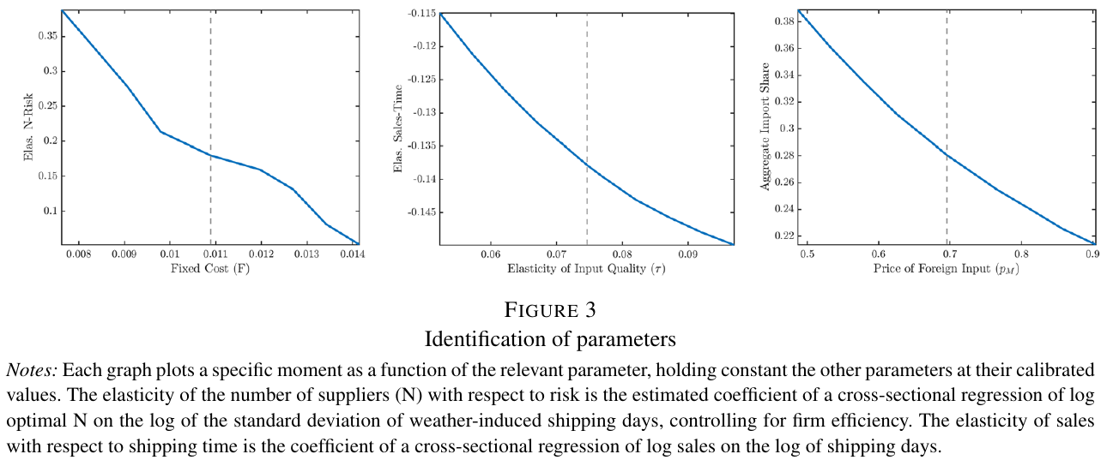
APPENDIX
Appendix: parameter sensitivity behind the calibration
Sensitivity of model moments, holding other parameters at calibrated values.
35 / 35
Notes:
Presenter notes (Q&A only; suggested speaking time: 0 seconds)
Figure 3 shows how model statistics vary with one parameter at a time while other parameters remain at their calibrated values. The left panel relates fixed costs of adding a source to source elasticity; the middle panel relates time sensitivity of quality to the sales elasticity with respect to transit time; the right panel relates the foreign-input price to the import share. The figure helps explain the calibration intuition, but it is not a standalone causal-identification result and does not imply that each parameter affects only one moment.
Source: Paper, p. 25, Figure 3. Original image with notes.
Blaum, Esposito and Heise (2026), Input Sourcing under Climate Risk: Evidence from U.S. Manufacturing Firms, Review of Economic Studies, DOI 10.1093/restud/rdag031.
The English summary, comparisons, and policy extensions are the presenter’s synthesis; sources for original figures and equations are identified.

